Slide 1

MBus: A power-aware interconnect for ultra-low power micro-scale system design
Pat Pannuto, University of Michigan
ppannuto@umich.edu
Advisor: Prabal Dutta, University of Michigan / UC Berkeley
prabal@umich.edu
PI: Dennis Sylvester, University of Michigan
dmcs@umich.edu

Slide 2
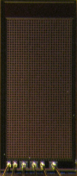
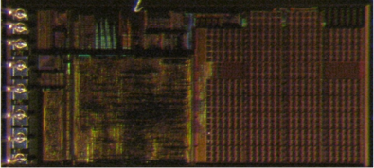
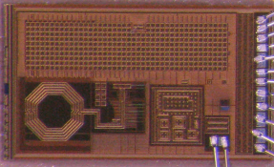
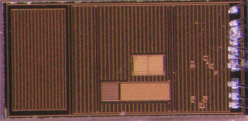
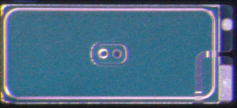

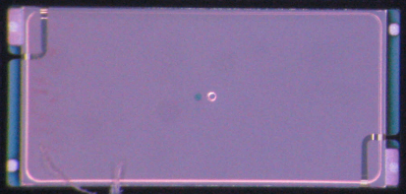
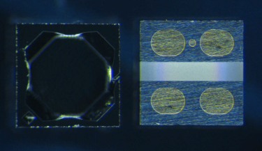
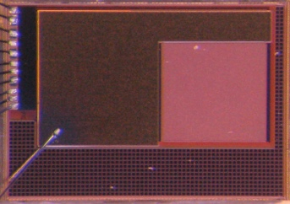
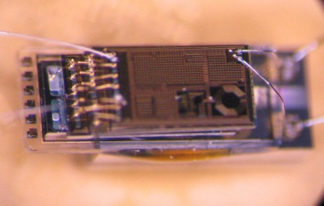
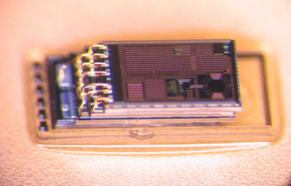
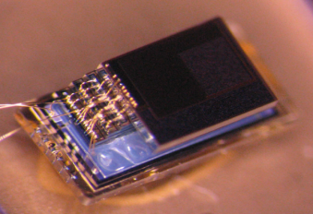
MBus is the interconnect for Michigan’s nanopower chips
Control/
PMU
Decap
Temp Sensor
Radio
+ CDC
2 uAh Battery
5 uAh Battery
MEMS
P. Sensor
Motion Detection/ Imager
Pressure Sensing
Temp. Sensing
Visual Sensing
Notes:
- heterog blocks; diff people -> systems
- unique needs pico-power
MBus has allowed us to compose a heterogeneous set of building blocks, designed by different people using different processes, into complete systems using an interconnect that addresses the unique needs of nano- and pico-power systems.

Slide 3
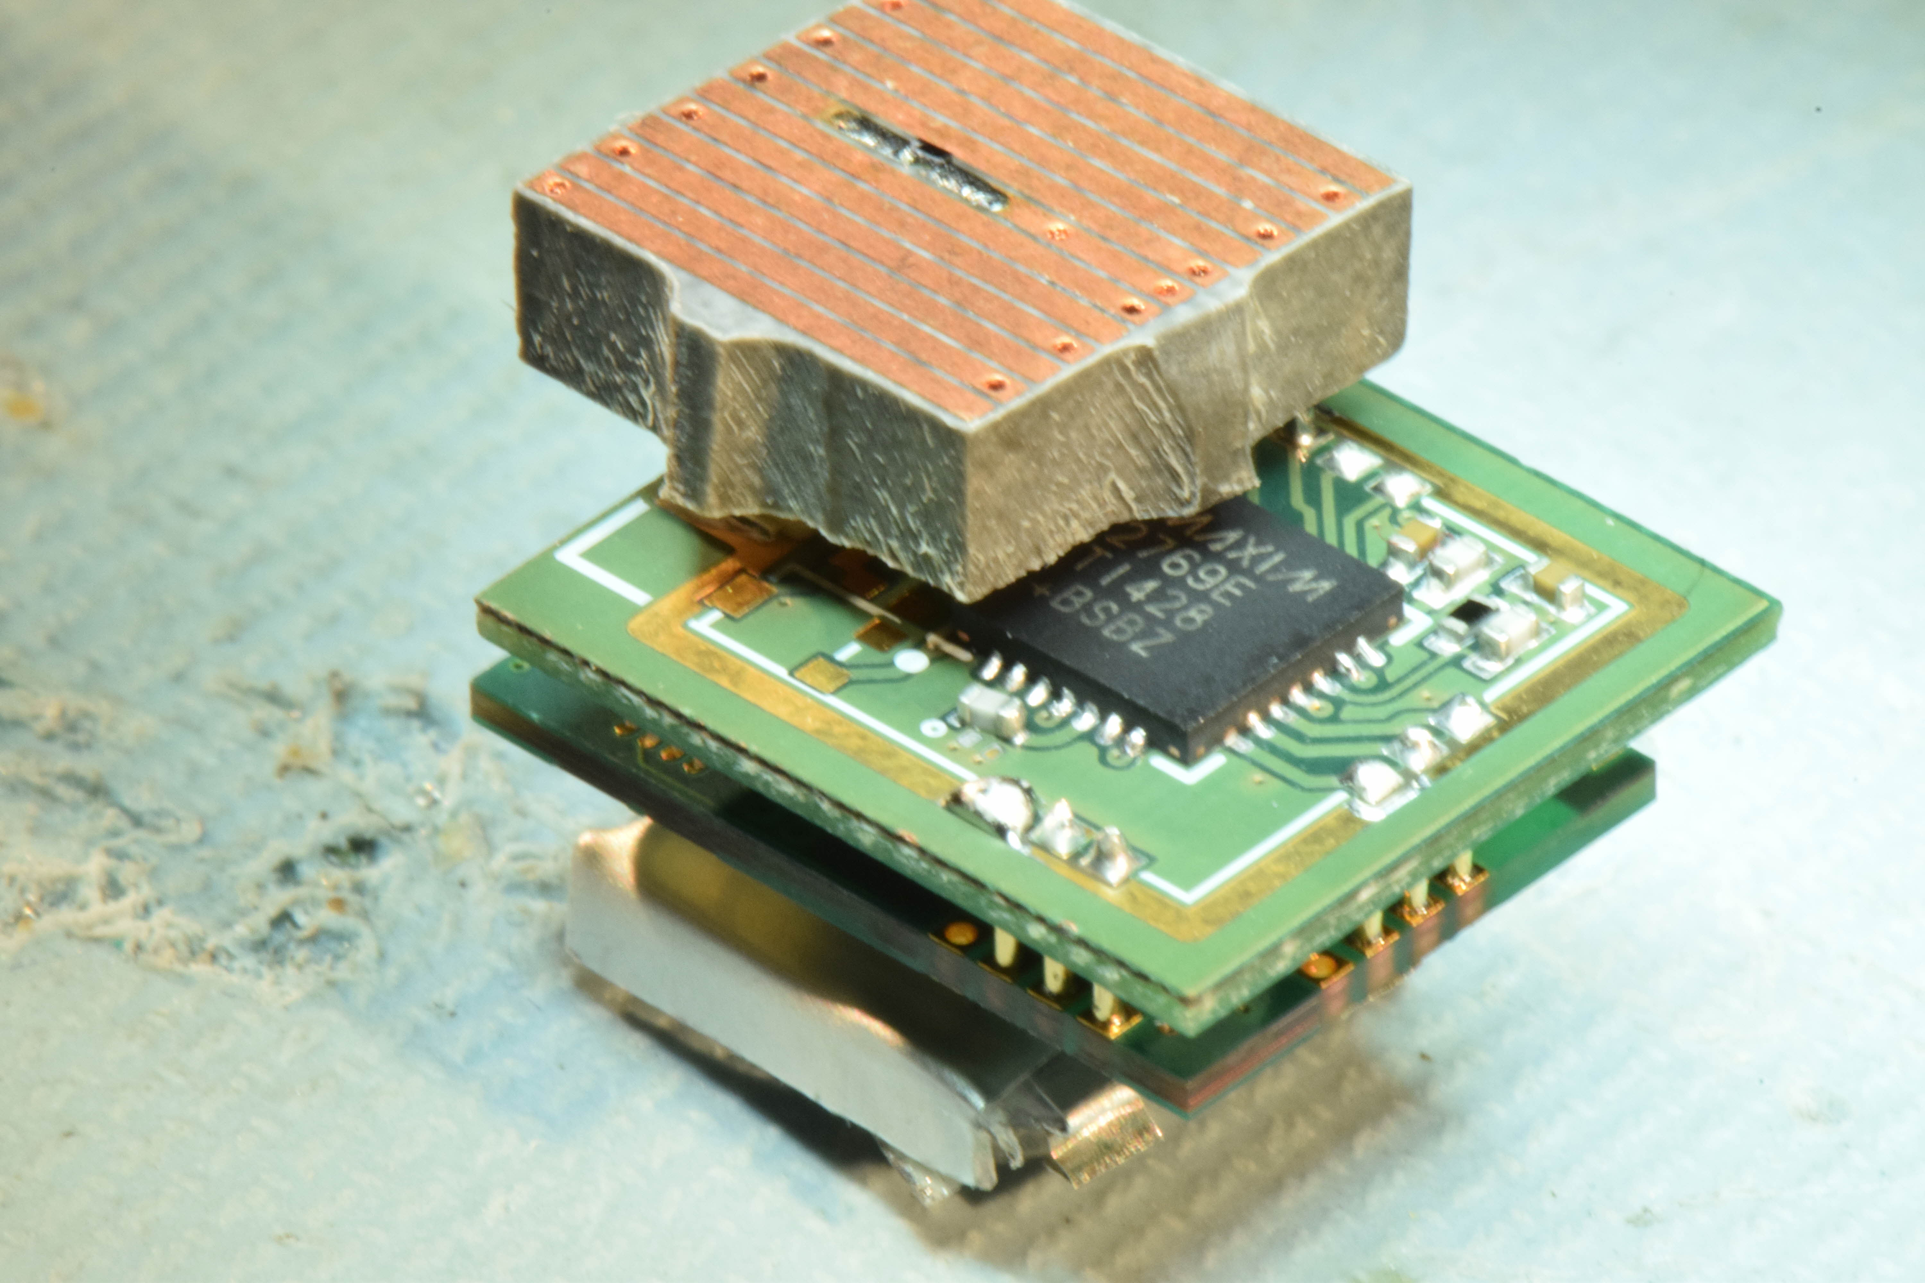
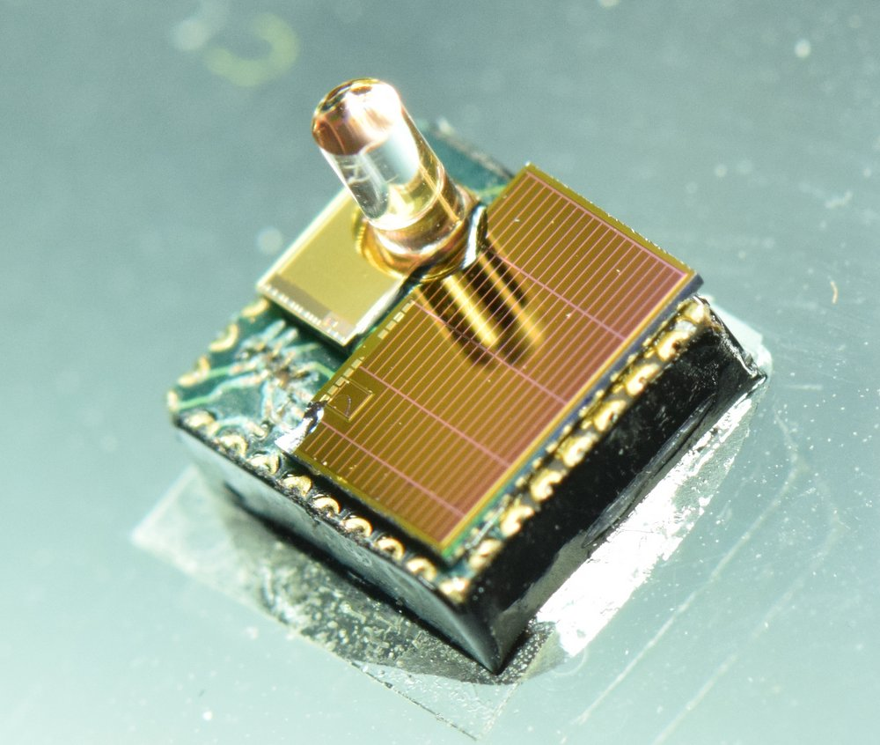
Growing ecosystems of MBus chips and systems
Processor (PRC/PREv13)
ARM Cortex M0
8 generations with MBus
Radios (RADv10, SIRv2, FFRv1, MRRv1)
900 MHz near field ; med range
~1 GHz far field
Flash Memory (FLSv2, FLPv1)
Long-term data retention
Sensor (SNSv7)
Generic CDC frontend
Energy Harvesters
SOLv5, HRVv4, GAPv3
Power Management (PMUv2)
Power regulation, brown-out detection
Imager (IMGv3)
160x160 pixel imager with < 1 µW motion detection
GPS Correlator (CORv2)
Acquire & record raw I/Q data
N-ZERO chips?
Notes:
- UM building blocks
- n-zero has nano-power front ends
- integration ; complete systems ; multiply program payoff
The set of building blocks at U-M are growing and, given this program’s focus on nano-power front ends, the opportunity is to not only demonstrate a diverse set of wakeup front ends but also integrate them to create multimodal wakeup or complete systems that can demonstrate nanopower system budgets, dramatically increasing the program’s payoff.

Slide 4
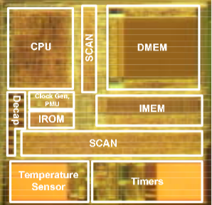
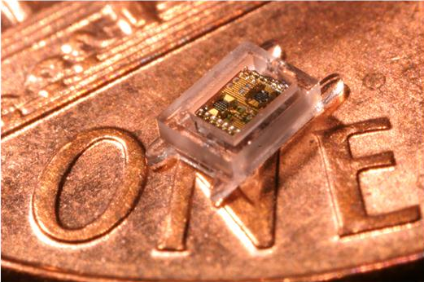
MBus addresses a modularity need
Michigan has a well-established history of low-power circuit design
Next challenge: low-power systems
Phoenix ’08, 30 pW temperature sensor
Monolithic designs slowed progress
Intraocular Pressure ‘11, semi-modular design
What would it take get reusable components?
The Phoenix Processor: A 30pW Platform for Sensor Applications, M. Seok, VLSI ’08
A Cubic-Millimeter Energy-Autonomous Wireless Intraocular Pressure Monitor, G. Chen, ISSCC ‘11
Notes:
? Monolithic systems continuously re-create ad-hoc interfaces

Slide 5
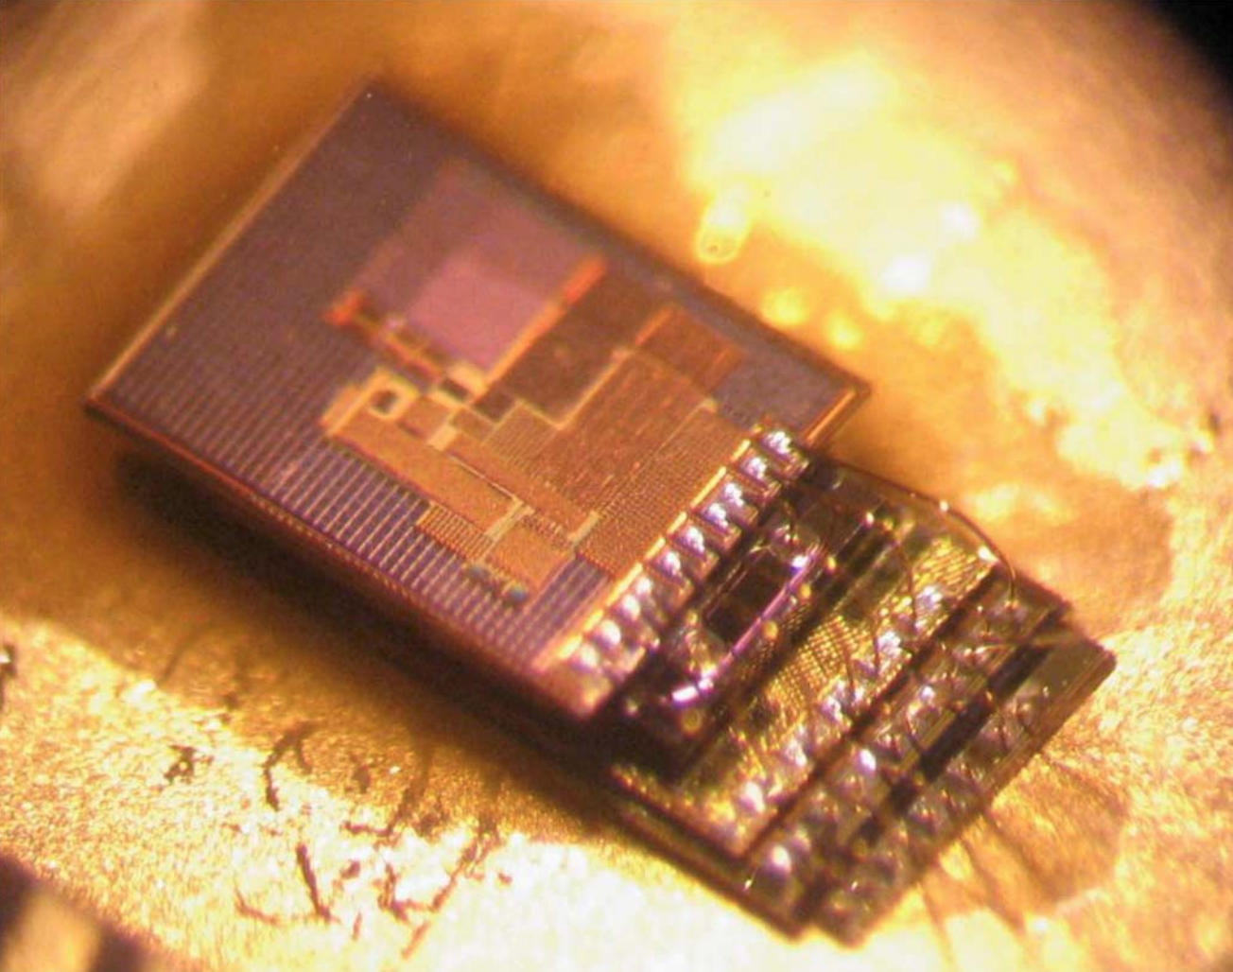
No existing embedded interconnect satisfied our needs
SPI
I/O overhead: per-chip select, interrupt lines
Centralized architecture inefficient
I²C
Pull-ups consume too much energy (~100 uW)
First Try: I²C variant
Not easily synthesizable, energy state tracking
Y. Lee, S. Bang, I. Lee, Y. Kim, G. Kim, M. H. Ghaed, P. Pannuto, P. Dutta, D. Sylvester, and D. Blaauw, “A modular 1 mm³ die-stacked sensing platform with low power I²C inter-die communication and multi-modal energy harvesting,” in IEEE Journal of Solid-State Circuits, vol. 48, 2013

Slide 6
The driving goals of the MBus design
Three things really motivated the team at first:
Power
Area
Reliability
Clean slate design compelled rigorous feature evaluation
Power, area, reliability, synthesizability, scalability (address space), flexibility (multi-master / interrupt), efficient (broadcast, HW ACK)
System design revelation: Power-aware

Slide 7
MBus Overview
Ring Topology
2 lines – 4 I/O per node
Clock
Data
Transaction oriented
Arbitration
Address Transmission
Data Transmission
Interjection
Control (ACK/NAK)
“Shoot-Through”
FOM (meas)
Active: 22 pJ / bit / chip
< 10 pW standby / chip
CLK_IN
CLK_OUT

Slide 8
In a distributed sensing system, automatic power management makes life much, much easier
Managing power modes presented some of the biggest challenges
Power state: which chips are on? CPU must turn peripherals on to talk to each other
Wakeup circuitry: custom clockless cold-boot required for each chip
Insight: Interconnect can handle power management
Arbitration protocol puts a few clock edges on the global bus
1. Node is awake and participating in arbitration
2. Node is asleep, bus frontend clocks wakeup circuitry on arbitration edges and powers on having just lost arbitration
Hierarchical power domains make this efficient
Minimal always-on frontend (7 gates)
Bus controller listens for address, provides byte-interface to bus, and powers rest of chip only when needed

Slide 9
The other big design accelerant for M3 systems was to standardize the layer controller
Common design pattern:
Chip state-machines triggered by register-file interface
Some require a small amount of configuration memory (registers)
Some require large actual memory (images, audio, etc)
All M3 chips have the same logical interface: MPQ
Essentially a distributed DMA interface
Facilitates distributed state machines
Send configurable messages on events, very flexible / composable

Slide 10
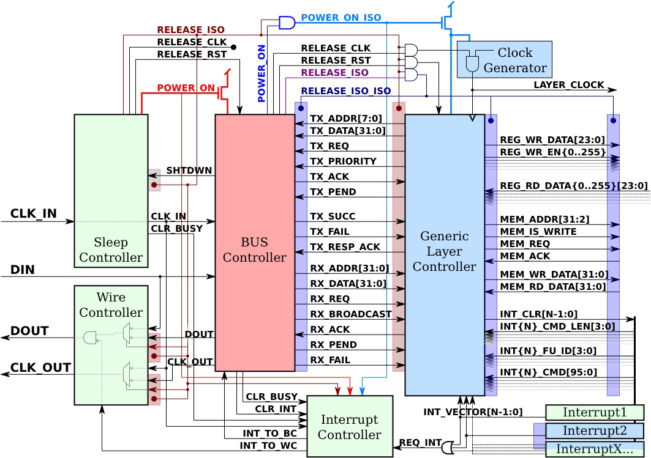
Status of MBus today
Synthesizable Verilog
Free, open source license
No process-specific parameters
(ratioed logic, etc)
FPGA and big-banged MCU implementations
Protocol Analyzer for Saleae Logic
Python library + debug board
Real-time programmatic interaction, read/write MBus from a PC
Exploring formal protocol verification

Slide 11
Additional Information
Overview
Pat Pannuto, Yoonmyung Lee, Ye-Sheng Kuo, ZhiYoong Foo, Benjamin Kempke, Gyouho Kim, Ronald G. Dreslinski, David Blaauw, and Prabal Dutta. “MBus: A System Integration Bus for the Modular Micro-Scale Computing Class”. In: vol. 37. Micro Top Picks 3. May 2016.
Architectural Design and Protocol Logic
Pat Pannuto, Yoonmyung Lee, Ye-Sheng Kuo, ZhiYoong Foo, Benjamin Kempke, Gyouho Kim, Ronald G. Dreslinski, David Blaauw, and Prabal Dutta. “MBus: An Ultra-Low Power Interconnect Bus for Next Generation Nanopower Systems”. In: Proceedings of the 42nd International Symposium on Computer Architecture. ISCA ’15. Portland, Oregon, USA: ACM, June 2015.
Circuit Design and Power Domains
Ye-Sheng Kuo, Pat Pannuto, Gyouho Kim, ZhiYoong Foo, Inhee Lee, Benjamin Kempke, Prabal Dutta, David Blaauw, and Yoonmyung Lee. “MBus: A 17.5 pJ/bit Portable Interconnect Bus for Millimeter-Scale Sensor Systems with 8 nW Standby Power”. In: CICC ’14: IEEE Custom Integrated Circuits Conference. San Jose, California, USA, Sept. 2014.
Specification
http://mbus.io/spec.html
Verilog
https://github.com/mbus/mbus
Homepage
http://mbus.io

Slide 12
For more information, specification, and reference verilog: http://mbus.io http://github.com/mbus/mbus
MBus Team: Pat Pannuto, Yoonmyung Lee, Ye-Sheng Kuo, ZhiYoong Foo, Benjamin Kempke, David Blaauw, Prabal Dutta
PI: Dennis Sylvester, University of Michigan
dmcs@umich.edu

Slide 13
Backups

Slide 14
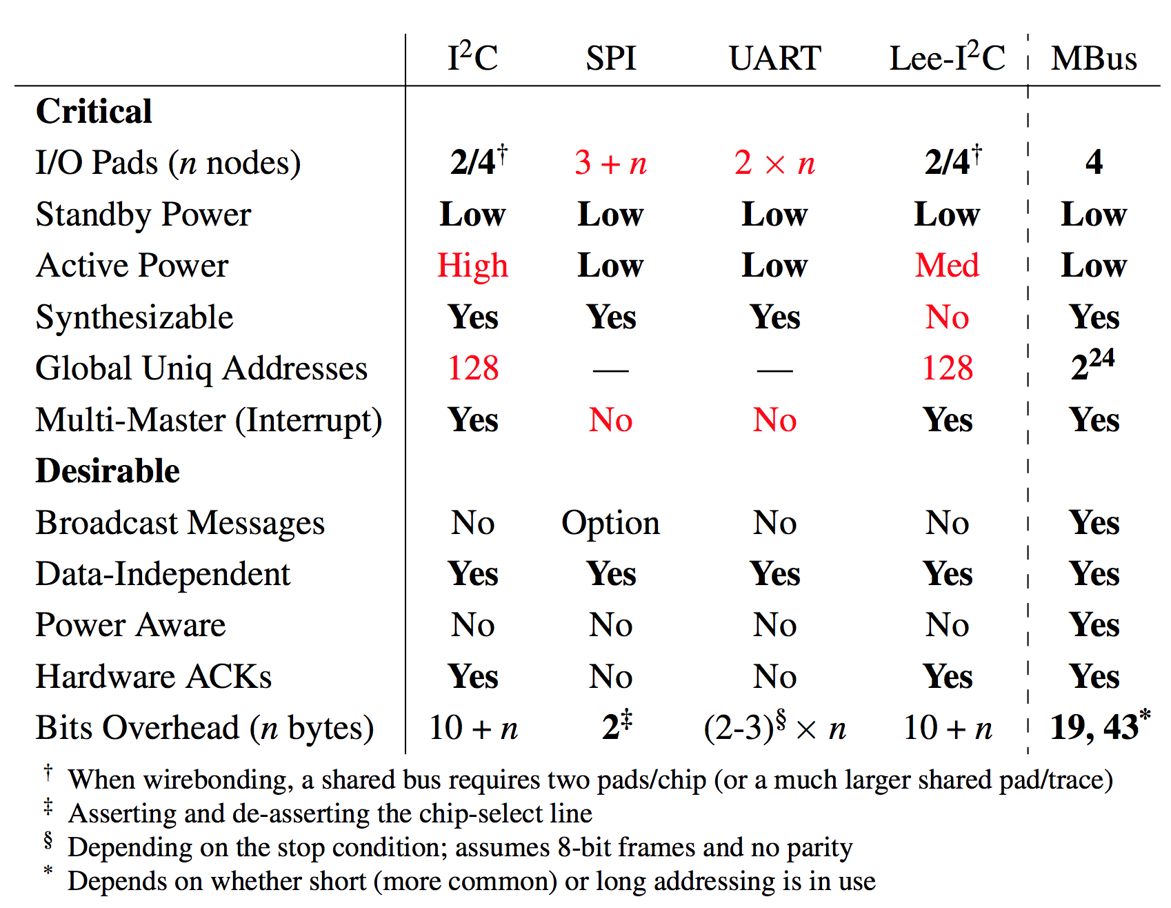
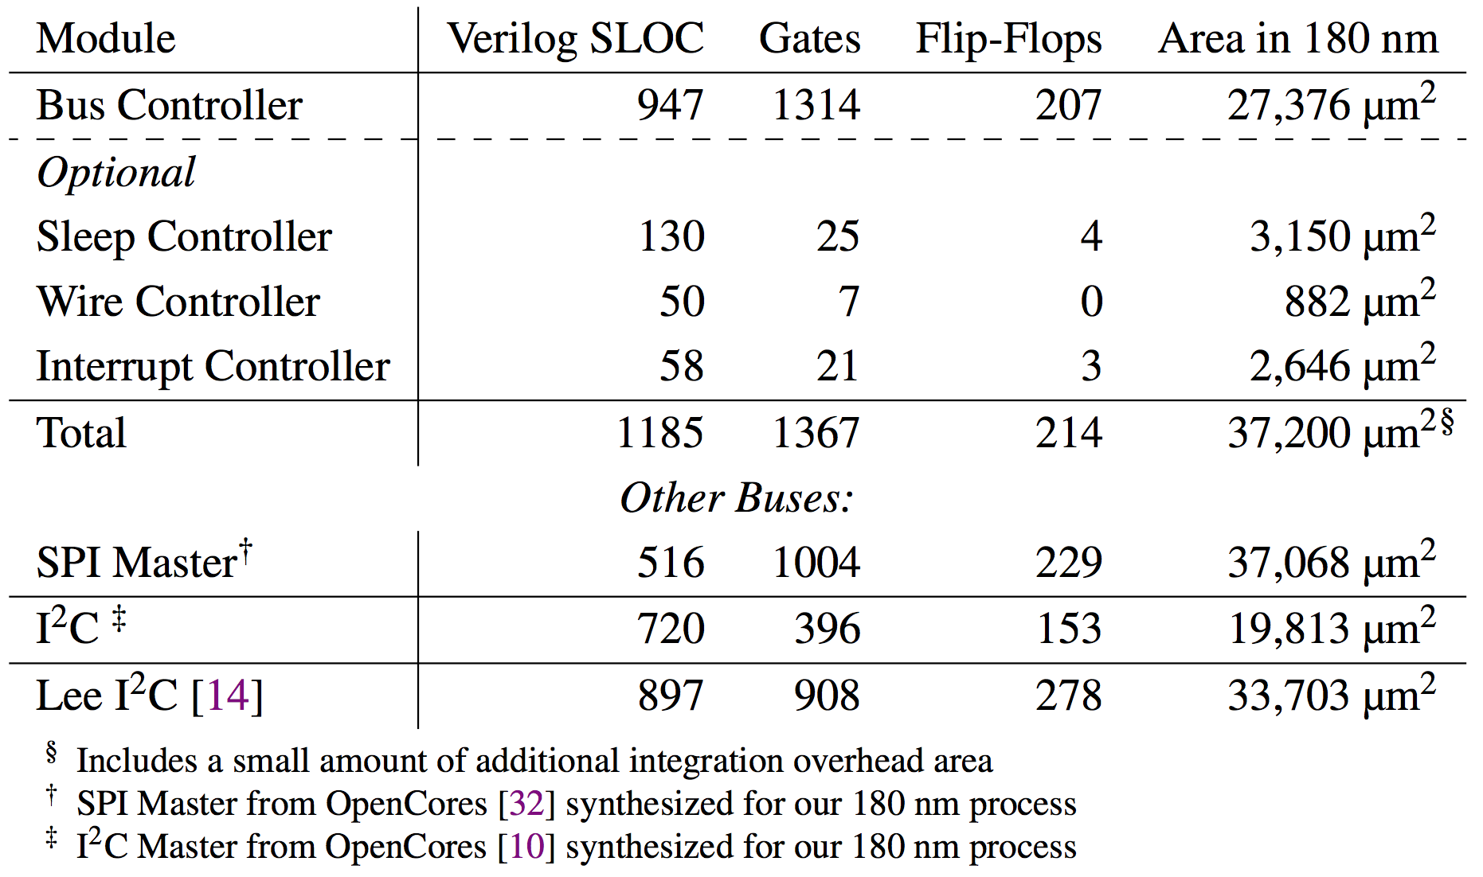
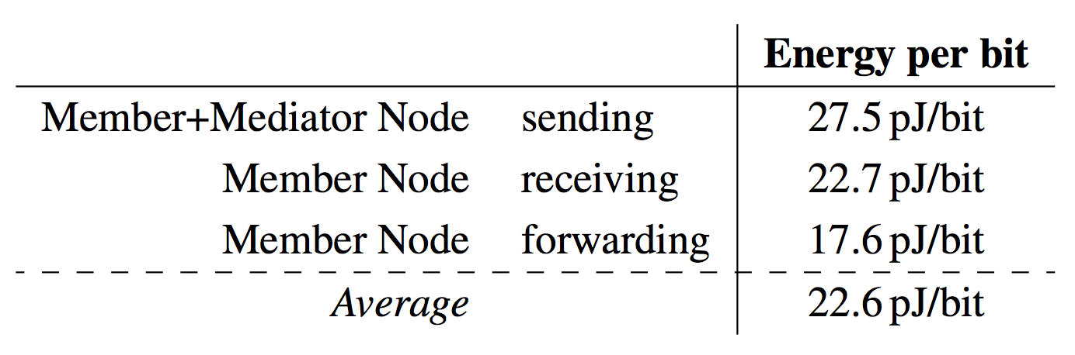
FOM’s

Slide 15
The TODOs in the specification
Some interoperability questions
Minimum drive strength
Standards or bounds for bus clock speed
CPU MMIO interface to MBus / MPQ internals
This is a more niche issue that should be in a different spec
”Future Extensions”
Obviated by MPQ streaming

Slide 16
M3 Evolution
Processor Evolution
Chip | #
PRC | v13
PRE | v13
RAD | v10
DCP | v8
SNS | v7
SOL | v5
HRV | v4
IMG | v3
GAP | v3
COR | v2
FLS | v2
SIR | v2
PMU | v2
FFR | v1
MRR | v1
ADO | v1
FLP | v1
2013
2014
2015
2016
v6
v9
v11
v1-5
Added MBUS
Added Layer Ctrl
Standardized PAD
GOC Reloc. & Resize
SRAM 3kB → 4kB
GOC Timeout Fix
Cfg. PMU Strength
Added Multiple GOC MBUS msg
Standardized Width & Lengths
Added Fiducial & Numbering
MBUS DIN Double Latch Fix
MBUS Wire Ctrl Fix
Prototypes
v7
v12
Minor Bug Fixes
v10
New SRAM 4kB → 8kB
Removed Integrated PMU
Standardized MBUS Layer CTRL
Added Arbitration Support
Improved CPF flow
PMUv1 Support
Minor Bug Fixes
MBUS Reset Command Fix
Shorten Watchdog Timer
Cfg. Auto-Wake-Up
MBUS Node Double Latching
v8
Increase # PMU taps
Cfg. MBUS Threshold
MBUS Wire Ctrl Glitch
Various Isolation Fixes
JTAG Removal
Clock Gen. Freq Increase
Added 5 Timers
v13
SRAM Sense Amp Fix
Added GOC Debug Support
Lowered GOC Default Timeout
LC Timing Violation Fixes
Added General MMIO in Arbitration
Misc. Bug Fixes

Slide 17
Embedded interconnect technology has not changed in over 30 years
If we re-examine…
Addressing
Acknowledgements
I²C acknowledges every byte
How often do NAKs happen?
To a random byte?
12.5% overhead
MBus ACKs transactions
Receiver can interject message

Slide 18
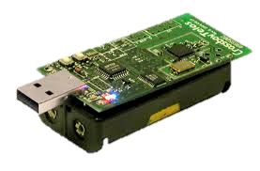
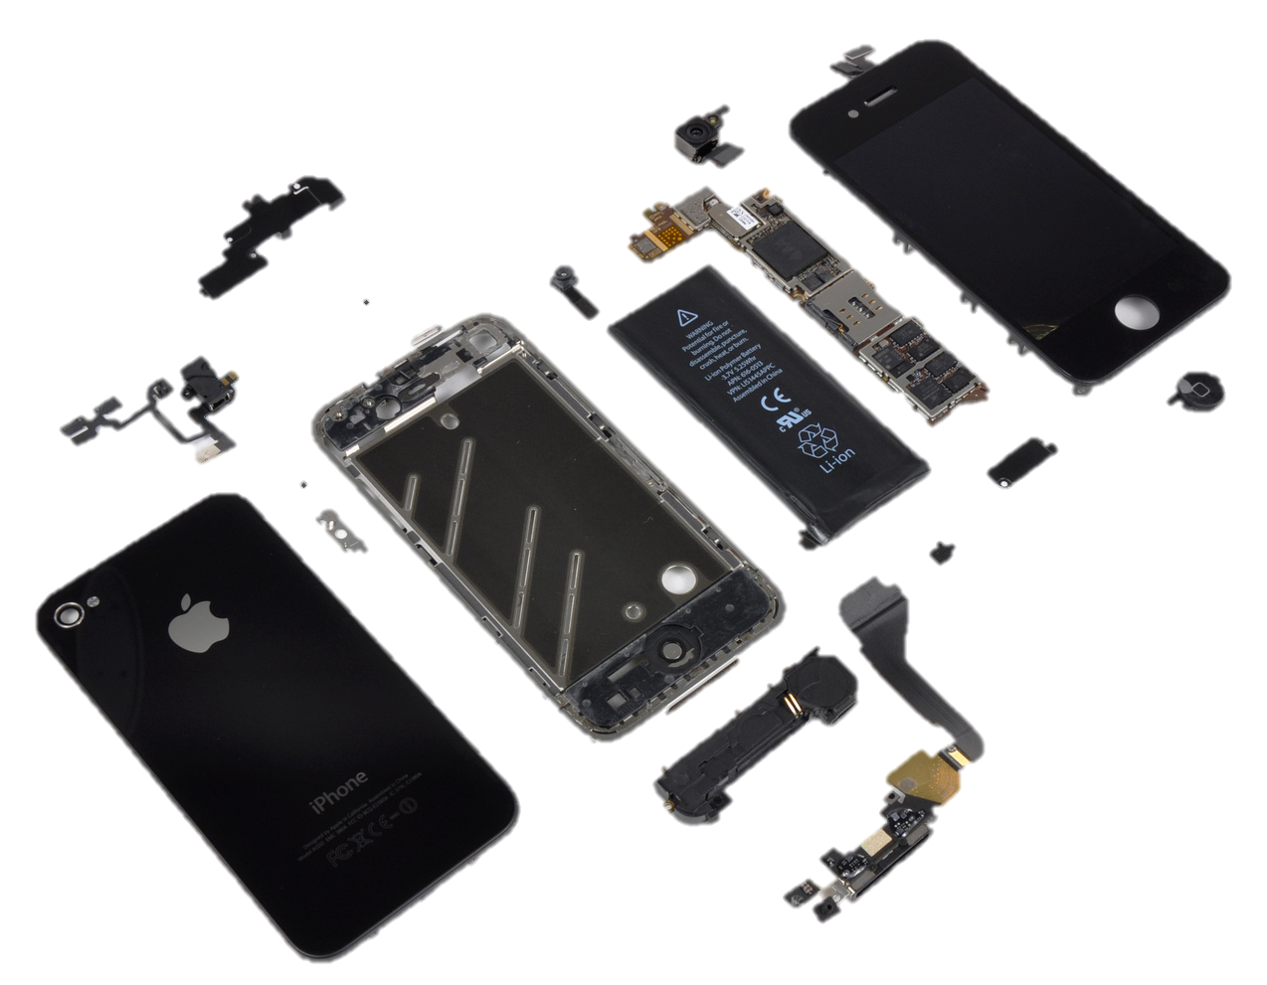
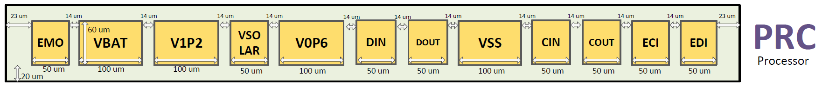
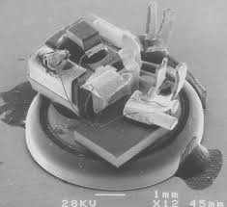
Millimeter-scale systems are small
Node volume is dominated by energy storage
And volume is shrinking cubically
I/O pads begin to account for non-trivial percentage of node surface area
“Phone”
Battery
“Sensor”
Batteries
1 mm = 1,000 μm
50 μm, minimum viable bond pad
“Sensor”
Battery
16-20 maximum I/O pins for 3D stacking
Budget 10’s μW active, 10’s nW sleep, DC 0.1%

